Slide 1
BLM206 Mikroişlemci Sistemleri
Chapter 8
Memory Access
M.Aydin - 2018

Slide 2
Course Objective
How data is organized in memory?
  Big Endian vs Little Endian
How data is addressed?
  Pre-index
  Post-index
  Pre-index with update

Slide 3
Logic View of Memory
By grouping bits together we can store more values
  8 bits = 1 byte
  16 bits = 2 bytes = 1 halfword
  32 bits = 4 bytes = 1 word
From software perspective, memory is an addressable array of bytes.
  The byte stored at the memory address 0x20000004 is 0b10000100
8 bits
High Address
0x20000007
01110010
0x20000006
00100101
0x20000005
11100010
0x20000004
10000100
0x20000003
01100001
0x20000002
10001111
0x20000001
00010010
0b10000100
0x84
132
0x20000000
10010100
Binary
Hexadecimal
Decimal
Low Address

Slide 4
Logic View of Memory
When we refer to memory locations by address, we can only do so in units of bytes, halfwords or words
Words
  32 bits = 4 bytes = 1 word = 2 halfwords
  In the right diagram, we have two words at addresses:
    0x20000000
    0x20000004
  Can you store a word anywhere? NO.
  A word can only be stored at an address that's divisible by 4.
  Memory address of a word is the lowest address of all four bytes in that word.
8 bits
High Address
0x20000007
01110010
0x20000006
00100101
0x20000005
11100010
0x20000004
10000100
0x20000003
01100001
0x20000002
10001111
0x20000001
00010010
0x20000000
10010100
  Word-address mod 4 = 0
Low Address

Slide 5
Logic View of Memory
We cannot store a word at address 0x20000002.
When we refer to memory locations by address, we can only do so in units of bytes, halfwords or words
Words
  32 bits = 4 bytes = 1 word = 2 halfwords
  In the right diagram, we have two words at addresses:
    0x20000000
    0x20000004
  Can you store a word anywhere? NO.
  A word can only be stored at an address that's divisible by 4.
  Memory address of a word is the lowest address of all four bytes in that word.
8 bits
High Address
0x20000007
01110010
0x20000006
00100101
0x20000005
11100010
0x20000004
10000100
0x20000003
01100001
0x20000002
10001111
0x20000001
00010010
0x20000000
10010100
  Word-address mod 4 = 0
Low Address

Slide 6
Logic View of Memory
When we refer to memory locations by address, we can only do so in units of bytes, halfwords or words
Halfwords
  16 bits = 2 bytes = 1 halfword
  The right diagram has four halfwords at addresses of:
    0x20000000
    0x20000002
    0x20000004
    0x20000006
  Can you store a halfword anywhere? NO.
  A halfword can only be stored at an address that's divisible by 2.
  Memory address of a halfword is the lowest address of its two bytes.
8 bits
High Address
0x20000007
01110010
0x20000006
00100101
0x20000005
11100010
0x20000004
10000100
0x20000003
01100001
0x20000002
10001111
0x20000001
00010010
0x20000000
10010100
Low Address
  Halfword-address mod 2 = 0

Slide 7
Logic View of Memory
We cannot store a halfword at address 0x20000001.
When we refer to memory locations by address, we can only do so in units of bytes, halfwords or words
Halfwords
  16 bits = 2 bytes = 1 halfword
  The right diagram has four halfwords at addresses of:
    0x20000000
    0x20000002
    0x20000004
    0x20000006
  Can you store a halfword anywhere? NO.
  A halfword can only be stored at an address that's divisible by 2.
  Memory address of a halfword is the lowest address of its two bytes.
8 bits
High Address
0x20000007
01110010
0x20000006
00100101
0x20000005
11100010
0x20000004
10000100
0x20000003
01100001
0x20000002
10001111
0x20000001
00010010
0x20000000
10010100
Low Address
  Halfword-address mod 2 = 0

Slide 8
Quiz
32-bit
Words
Bytes
Addr.
0015
Addr
=
??
0014
Word 3
0013
0012
What are the memory address of these four words?
0011
Addr
=
??
0010
Word 2
0009
0008
0007
Addr
=
??
0006
Word 1
0005
0004
0003
Addr
=
??
0002
Word 0
0001
0000

Slide 9
Quiz (Answer)
32-bit
Words
Bytes
Addr.
0015
Addr
=
0x0012
0014
Word 3
0013
0012
What are the memory address of these four words?
0011
Addr
=
0x0008
0010
Word 2
0009
0008
0007
Addr
=
0x0004
0006
Word 1
0005
0004
0003
Addr
=
0x0000
0002
Word 0
0001
0000

Slide 10
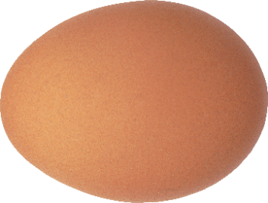

Endianess
High address
MSB
LSB
Little Endian
Big Endian
LSB
MSB
Low address
byte 3 byte 2 byte 1 byte 0
Little endian
msb
lsb
Big endian
byte 0 byte 1 byte 2 byte 3

Slide 11
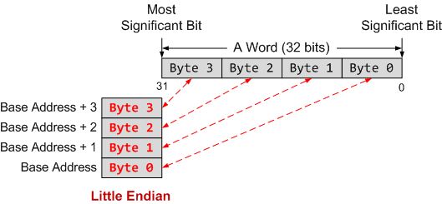
Endianess
Little Endian: Most significant byte is stored at a high address
Big Endian: Most significant byte is stored at a low address
Regardless endian, the address of a word is defined as the lowest address of all bytes it occupies.
ARM is Little Endian by default. However it can be made Big Endian by configuration.

Slide 12
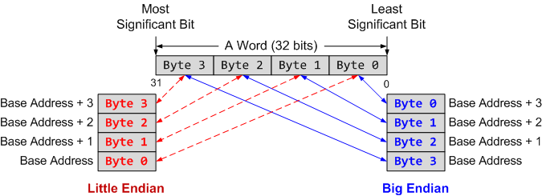
Endianess
Little Endian: Most significant byte is stored at a high address
Big Endian: Most significant byte is stored at a low address
Regardless endian, the address of a word is defined as the lowest address of all bytes it occupies.
ARM is Little Endian by default. However it can be made Big Endian by configuration.

Slide 13
Example
If big endianess is used
The word stored at address 0x20008000 is
Memory Address | Memory Data
0x20008003 | 0xA7
0x20008002 | 0x90
0x20008001 | 0x8C
0x20008000 | 0xEE
0xEE8C90A7
Notes:
Halfword access and signed halfword/byte accesses were added to the architecture in v4T, this is the reason the offset field is not as flexible as the normal word/byte load/store - not a problem because these accesses are less common.
Link: diagram on next slide

Slide 14
Example
If little endianess is used
The word stored at address 0x20008000 is
Memory Address | Memory Data
0x20008003 | 0xA7
0x20008002 | 0x90
0x20008001 | 0x8C
0x20008000 | 0xEE
0xA7908CEE
Endian only specifies byte order, not bit order in a byte!
Notes:
Halfword access and signed halfword/byte accesses were added to the architecture in v4T, this is the reason the offset field is not as flexible as the normal word/byte load/store - not a problem because these accesses are less common.
Link: diagram on next slide

Slide 15
Load-Modify-Store
C statement
x = x + 1;
; Assume the memory address of x is stored in r1
LDR r0, [r1] ; load value of x from memory
ADD r0, r0, #1 ; x = x + 1
STR r0, [r1] ; store x into memory
Notes:
Assume x is a 32-bit integer stored in the memory

Slide 16
Load Instructions
LDR rt, [rs]
  fetch data from memory into register rt.
  The memory address is specified in register rs.
  For Example:
; Assume r0 = 0x08200004
; Load a word:
LDR r1, [r0] ; r1 = Memory.word[0x08200004]

Slide 17
Store Instructions
STR rt, [rs]:
  save data in register rt into memory
  The memory address is specified in a base register rs.
  For Example:
; Assume r0 = 0x08200004
; Store a word
STR r1, [r0] ; Memory.word[0x08200004] = r1

Slide 18
Single register data transfer
LDR | Load Word
LDRB | Load Byte
LDRH | Load Halfword
LDRSB | Load Signed Byte
LDRSH | Load Signed Halfword
STR | Store Word
STRB | Store Lower Byte
STRH | Store Lower Halfword
Notes:
Point out destination (reg) first for LDR, but destination (mem) last for STR. Different to Motorola, but it keeps the instruction mnemonic format consistent. Always have register loaded/stored first, then address accessed second
Size specifier comes out on MAS (memory access size) signal. Important that memory supports full range of accesses - especially important for writes where only the specified size should be written.
Special types of sign extended load - this is needed because ARM registers only hold 32-bit values. Draw diagram. No need for special store instructions though.
Instruction cycle timing:
STR LDR
7TDMI 2 cycles 3 cycles
9TDMI 1 cycle 1 cycle - interlock if used in next cycle
StrongARM1 1 cycle 1 cycle - interlock if used in next cycle
Xscale 1 cycle 1 cycle - interlock if used in next 2 cycles
Note size specifier comes after condition code.
Link: <address> explained on next slide.
Note that load/store instructions never set condition codes.

Slide 19
Load a Byte, Half-word, Word
Load a Byte
LDRB r1, [r0]
0x00
0x00
0x00
0xE1
0x02000003
0x87
0x02000002
0x65
31
0
0xE3
0x02000001
0x02000000
0xE1
Load a Halfword
LDRH r1, [r0]
Little Endian
0x00
0x00
0xE3
0xE1
31
0
Assume
r0 = 0x02000000
Load a Word
LDR r1, [r0]
0x87
0x65
0xE3
0xE1
31
0

Slide 20
Sign Extension
Load a Signed Byte
LDRSB r1, [r0]
0xFF
0xFF
0xFF
0xE1
0x20000003
0x87
0x20000002
0x65
31
0
0xE3
0x20000001
0x20000000
0xE1
Load a Signed Halfword
LDRSH r1, [r0]
Little Endian
0xFF
0xFF
0xE3
0xE1
31
0
Assume
r0 = 0x02000000
Facilitate subsequent 32-bit signed arithmetic!

Slide 21
Address
Address accessed by LDR/STR is specified by a base register plus an offset
For word and unsigned byte accesses, offset can be
  An unsigned 12-bit immediate value (i.e. 0 - 4095 bytes).
  LDR r0,[r1,#8]
  A register, optionally shifted by an immediate value
  LDR r0,[r1,r2]
  LDR r0,[r1,r2,LSL#2]
This can be either added or subtracted from the base register:
LDR r0,[r1,#-8]
LDR r0,[r1,-r2]
LDR r0,[r1,-r2,LSL#2]
For halfword and signed halfword / byte, offset can be:
  An unsigned 8 bit immediate value (i.e. 0-255 bytes).
  A register (unshifted).
Choice of pre-indexed or post-indexed addressing
Notes:
Halfword access and signed halfword/byte accesses were added to the architecture in v4T, this is the reason the offset field is not as flexible as the normal word/byte load/store - not a problem because these accesses are less common.
Link: diagram on next slide

Slide 22
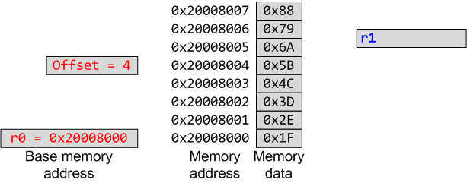
Pre-index
Pre-Index: LDR r1, [r0, #4]
Offset range is -255 to +255

Slide 23
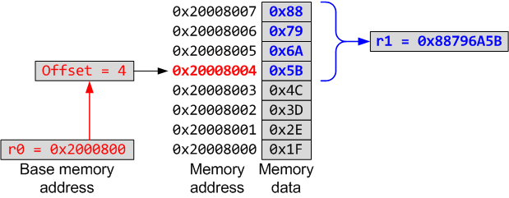
Pre-index
Pre-Index: LDR r1, [r0, #4]
Offset range is -255 to +255
Notes:
“!” indicates “writeback” i.e. the base register is to be updated after the instruction.
No “!” for post-indexed because post-increment of base register always happens (otherwise the offset field would not be used at all).
Give C example:
int *ptr;
x = *ptr++;
Compiles to a single instruction:
LDR r0, [r1], #4

Slide 24
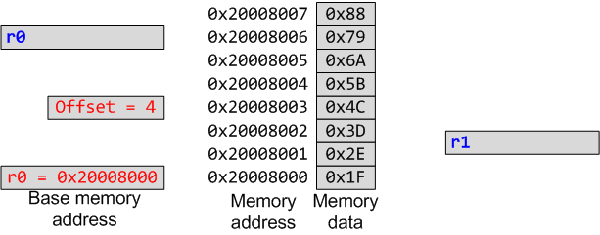
Post-index
Post-Index: LDR r1, [r0], #4
Offset range is -255 to +255
Notes:
“!” indicates “writeback” i.e. the base register is to be updated after the instruction.
No “!” for post-indexed because post-increment of base register always happens (otherwise the offset field would not be used at all).
Give C example:
int *ptr;
x = *ptr++;
Compiles to a single instruction:
LDR r0, [r1], #4

Slide 25
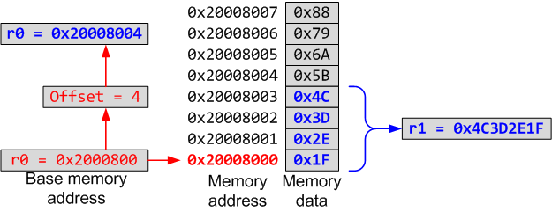
Post-index
Post-Index: LDR r1, [r0], #4
Offset range is -255 to +255
Notes:
“!” indicates “writeback” i.e. the base register is to be updated after the instruction.
No “!” for post-indexed because post-increment of base register always happens (otherwise the offset field would not be used at all).
Give C example:
int *ptr;
x = *ptr++;
Compiles to a single instruction:
LDR r0, [r1], #4

Slide 26
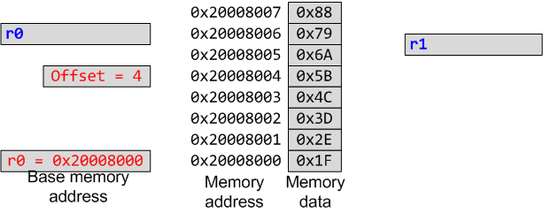
Pre-index with Updates
Pre-Index with Update: LDR r1, [r0, #4]!
Offset range is -255 to +255
Notes:
“!” indicates “writeback” i.e. the base register is to be updated after the instruction.
No “!” for post-indexed because post-increment of base register always happens (otherwise the offset field would not be used at all).
Give C example:
int *ptr;
x = *ptr++;
Compiles to a single instruction:
LDR r0, [r1], #4

Slide 27
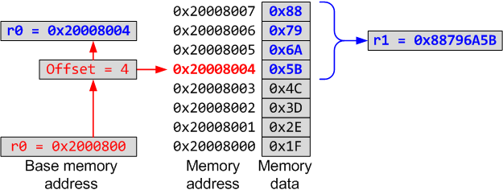
Pre-index with Updates
Pre-Index: LDR r1, [r0, #4]
Offset range is -255 to +255
Notes:
“!” indicates “writeback” i.e. the base register is to be updated after the instruction.
No “!” for post-indexed because post-increment of base register always happens (otherwise the offset field would not be used at all).
Give C example:
int *ptr;
x = *ptr++;
Compiles to a single instruction:
LDR r0, [r1], #4

Slide 28
Summary of Pre-index and Post-index
Index Format | Example | Equivalent
Pre-index | LDR r1, [r0, #4] | r1 ← memory[r0 + 4], r0 is unchanged
Pre-index with update | LDR r1, [r0, #4]! | r1 ← memory[r0 + 4] r0 ← r0 + 4
Post-index | LDR r1, [r0], #4 | r1 ← memory[r0] r0 ← r0 + 4
Offset range is -255 to +255
Notes:
Halfword access and signed halfword/byte accesses were added to the architecture in v4T, this is the reason the offset field is not as flexible as the normal word/byte load/store - not a problem because these accesses are less common.
Link: diagram on next slide

Slide 29
Example
LDRH r1, [r0]
; r0 = 0x20008000
Memory Address | Memory Data
0x20008003 | 0x89
0x20008002 | 0xAB
0x20008001 | 0xCD
0x20008000 | 0xEF
r1 before load
0x12345678
r1 after load
0x0000CDEF
Notes:
Halfword access and signed halfword/byte accesses were added to the architecture in v4T, this is the reason the offset field is not as flexible as the normal word/byte load/store - not a problem because these accesses are less common.
Link: diagram on next slide

Slide 30
Example
LDSB r1, [r0]
; r0 = 0x20008000
Memory Address | Memory Data
0x20008003 | 0x89
0x20008002 | 0xAB
0x20008001 | 0xCD
0x20008000 | 0xEF
r1 before load
0x12345678
r1 after load
0xFFFFFFEF
Notes:
Halfword access and signed halfword/byte accesses were added to the architecture in v4T, this is the reason the offset field is not as flexible as the normal word/byte load/store - not a problem because these accesses are less common.
Link: diagram on next slide

Slide 31
Example
STR r1, [r0], #4
; r0 = 0x20008000, r1=0x76543210
Memory Address | Memory Data
0x20008007 | 0x00
0x20008006 | 0x00
0x20008005 | 0x00
0x20008004 | 0x00
0x20008003 | 0x00
0x20008002 | 0x00
0x20008001 | 0x00
0x20008000 | 0x00
r0 before store
0x20008000
r0 after store
Notes:
Halfword access and signed halfword/byte accesses were added to the architecture in v4T, this is the reason the offset field is not as flexible as the normal word/byte load/store - not a problem because these accesses are less common.
Link: diagram on next slide

Slide 32
Example
STR r1, [r0], #4
; r0 = 0x20008000, r1=0x76543210
Memory Address | Memory Data
0x20008007 | 0x00
0x20008006 | 0x00
0x20008005 | 0x00
0x20008004 | 0x00
0x20008003 | 0x76
0x20008002 | 0x54
0x20008001 | 0x32
0x20008000 | 0x10
r0 before store
0x20008000
r0 after store
0x20008004
Notes:
Halfword access and signed halfword/byte accesses were added to the architecture in v4T, this is the reason the offset field is not as flexible as the normal word/byte load/store - not a problem because these accesses are less common.
Link: diagram on next slide

Slide 33
Example
STR r1, [r0, #4]
; r0 = 0x20008000, r1=0x76543210
Memory Address | Memory Data
0x20008007 | 0x00
0x20008006 | 0x00
0x20008005 | 0x00
0x20008004 | 0x00
0x20008003 | 0x00
0x20008002 | 0x00
0x20008001 | 0x00
0x20008000 | 0x00
r0 before the store
0x20008000
r0 after the store
Notes:
Halfword access and signed halfword/byte accesses were added to the architecture in v4T, this is the reason the offset field is not as flexible as the normal word/byte load/store - not a problem because these accesses are less common.
Link: diagram on next slide

Slide 34
Example
STR r1, [r0, #4]
; r0 = 0x20008000, r1=0x76543210
Memory Address | Memory Data
0x20008007 | 0x76
0x20008006 | 0x54
0x20008005 | 0x32
0x20008004 | 0x10
0x20008003 | 0x00
0x20008002 | 0x00
0x20008001 | 0x00
0x20008000 | 0x00
r0 before store
0x20008000
r0 after store
0x20008000
Notes:
Halfword access and signed halfword/byte accesses were added to the architecture in v4T, this is the reason the offset field is not as flexible as the normal word/byte load/store - not a problem because these accesses are less common.
Link: diagram on next slide

Slide 35
Example
STR r1, [r0, #4]!
; r0 = 0x20008000, r1=0x76543210
Memory Address | Memory Data
0x20008007 | 0x00
0x20008006 | 0x00
0x20008005 | 0x00
0x20008004 | 0x00
0x20008003 | 0x00
0x20008002 | 0x00
0x20008001 | 0x00
0x20008000 | 0x00
r0 before store
0x20008000
r0 after store
Notes:
Halfword access and signed halfword/byte accesses were added to the architecture in v4T, this is the reason the offset field is not as flexible as the normal word/byte load/store - not a problem because these accesses are less common.
Link: diagram on next slide

Slide 36
Example
STR r1, [r0, #4]!
; r0 = 0x20008000, r1=0x76543210
Memory Address | Memory Data
0x20008007 | 0x76
0x20008006 | 0x54
0x20008005 | 0x32
0x20008004 | 0x10
0x20008003 | 0x00
0x20008002 | 0x00
0x20008001 | 0x00
0x20008000 | 0x00
r0 before store
0x20008000
r0 after store
0x20008004
Notes:
Halfword access and signed halfword/byte accesses were added to the architecture in v4T, this is the reason the offset field is not as flexible as the normal word/byte load/store - not a problem because these accesses are less common.
Link: diagram on next slide

Slide 37
Example
If big endianess is used
LDR r11, [r0]
; r0 = 0x20008000
Memory Address | Memory Data
0x20008003 | 0xEE
0x20008002 | 0x8C
0x20008001 | 0x90
0x20008000 | 0xA7
r11 before load
0x12345678
r11 after load
0xA7908CEE
Notes:
Halfword access and signed halfword/byte accesses were added to the architecture in v4T, this is the reason the offset field is not as flexible as the normal word/byte load/store - not a problem because these accesses are less common.
Link: diagram on next slide

Slide 38
Load/Store Multiple Registers
STMxx rn{!}, {register_list}
LDMxx rn{!}, {register_list}
xx = IA, IB, DA, or DB
Addressing Modes | Description | Instructions
IA | Increment After | STMIA, LDMIA
IB | Increment Before | STMIB, LDMIB
DA | Decrement After | STMDA, LDMDA
DB | Decrement Before | STMDB, LDMDB
IA: address is incremented by 4 after a word is loaded or stored.
IB: address is incremented by 4 before a word is loaded or stored.
DA: address is decremented by 4 after a word is loaded or stored.
DB: address is decremented by 4 before a word is loaded or stored.

Slide 39
Load/Store Multiple Registers
The following are synonyms.
  STM = STMIA (Increment After) = STMEA (Empty Ascending)
  LDM = LDMIA (Increment After) = LDMFD (Full Descending)
The order in which registers are listed does not matter
  For STM/LDM, the lowest-numbered register is stored/loaded at the lowest memory address.

Slide 40
Store Multiple Registers

Slide 41
Load Multiple Registers

Slide 42
Cortex-M3 & Cortex-M4 Memory Map
32-bit Memory Address
2³² bytes of memory space (4 GB)
Harvard architecture: physically separated instruction memory and data memory
0xFFFFFFFF
Vendor Specific
0.5GB
External Peripheral Bus
0xE0100000
Internal Peripheral Bus
0xE0040000
0xE0000000
1GB
External Device
0xA0000000
1GB
External RAM
Peripheral
0x60000000
0.5GB
0x40000000
0.5GB
SRAM
0x20000000
0.5GB
Code
0x00000000

Slide 43
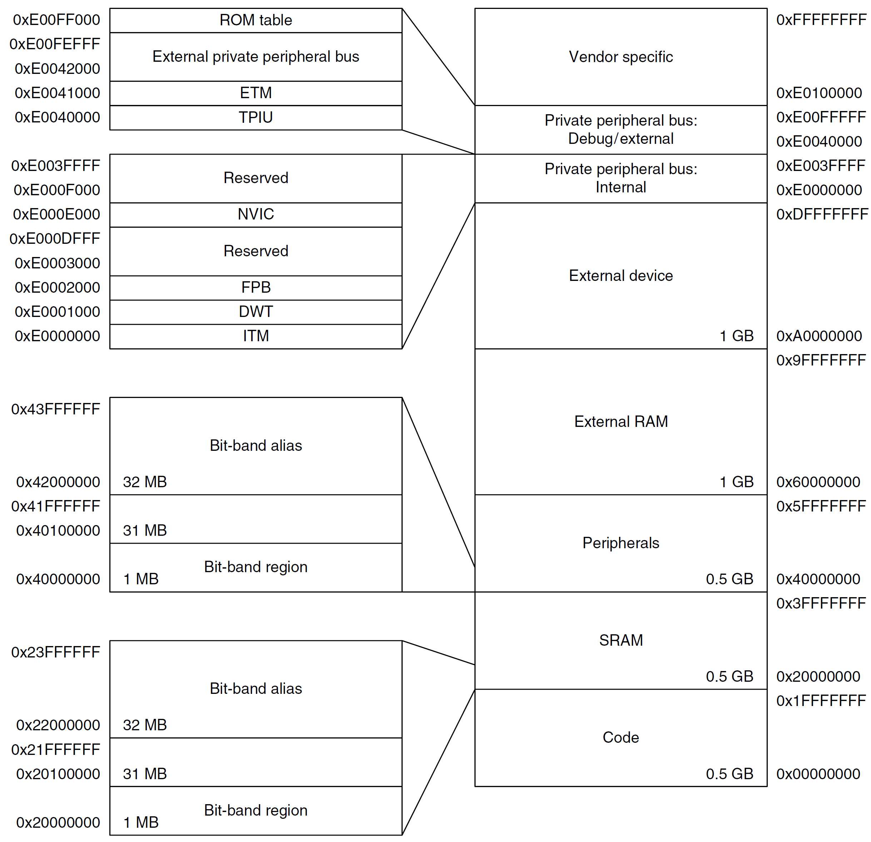
Cortex-M3 Fixed Memory Map

Slide 44
Cortex-M4 Fixed Memory Map

Slide 45
Summary
Memory address is always in terms of bytes.
How data is organized in memory?
How data is addressed?
Addressing Format | Example | Equivalent
Pre-index | LDR r1, [r0, #4] | r1 ← memory[r0 + 4], r0 is unchanged
Pre-index with update | LDR r1, [r0, #4]! | r1 ← memory[r0 + 4] r0 ← r0 + 4
Post-Index | LDR r1, [r0], #4 | r1 ← memory[r0] r0 ← r0 + 4

Slide 46
Reference:
Embedded Systems with ARM Cortex-M Microcontrollers in Assembly Language and C
Dr. Yifeng Zhu
Electrical and Computer Engineering
University of Maine

